Slide 1
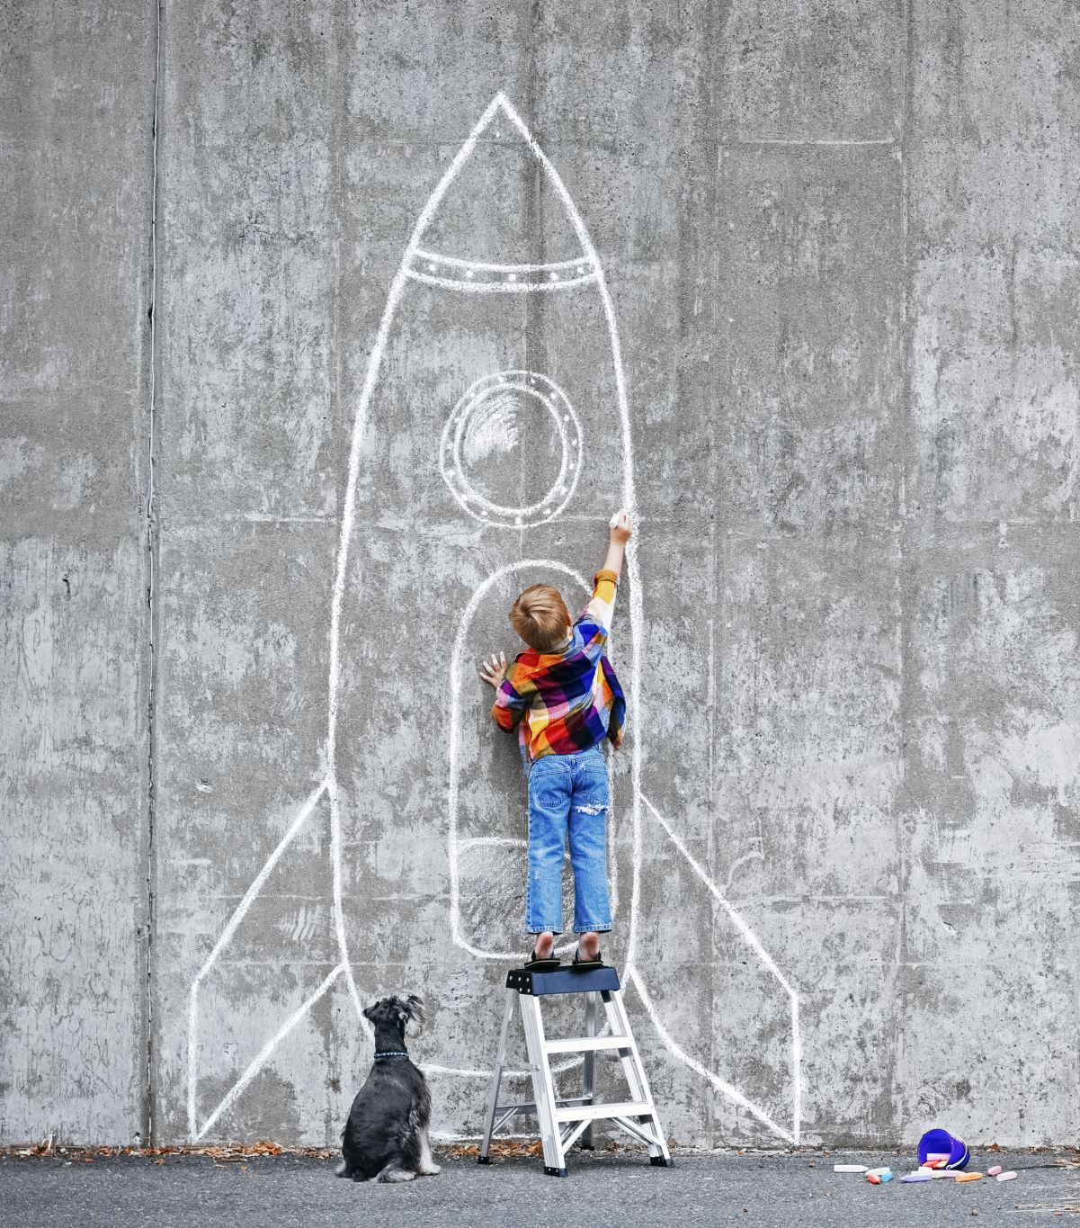
How your hobby can help advance your profession

Slide 2
Ideation…
It makes you more interesting….
Expand your network
We can do that?
Relieve some stress
Exercise, gardening,
Lower blood pressure
Enfiguration
Creativity
RDD – Resume Driven Design
Mailbox Money
Make it a habit
Schedule some time…. With others…
Show off a bit….
Get in the zone to forget your day to day worries.
Bills, chores, work, that creepy person that keeps stealing your lunch…
Watch less TV!
Nothing is on fire…. So you can go deep and enjoy the journey
How to choose?
Must be enjoyable
Doesn’t matter if you are “good” at it….
Better job satisfaction
Generally Happier
Examples of people and their hobbies
Buffet and his udileli
Gates readds….. A lot
How does underwater basket weaving help my profession…..

